Slide 2
MILWAUKEE

Slide 3
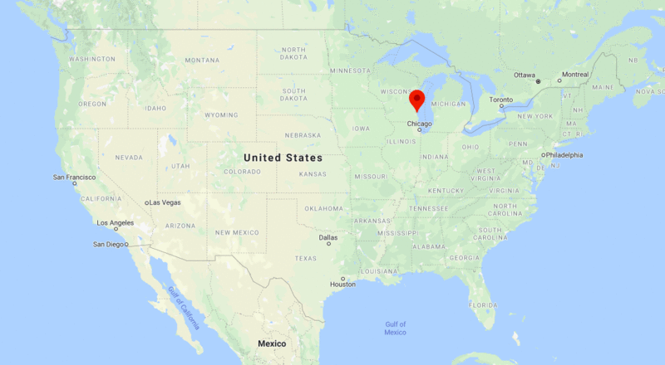

Slide 4
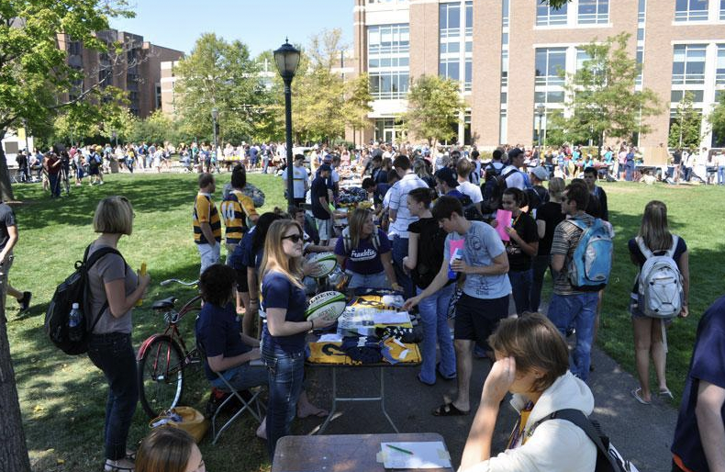
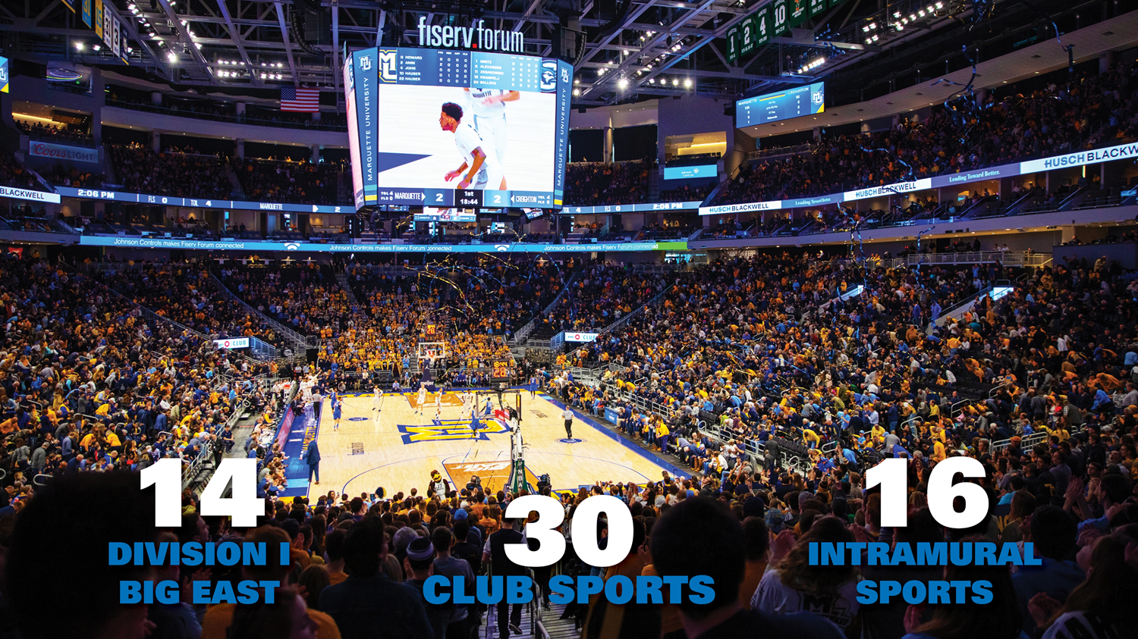
Campus Life

Slide 7
Marquette Updates 2023
#86
#41
Most Innovative Schools
US News & World Report National Universities
#6
Graduate Employment Rate (95.55%)
#12
Best Undergraduate Teaching
#22
Finance
#18
Supply Chain Management

Slide 8
Marquette Updates 2023
US News Rankings
HIGHLY RANKED PROGRAMS (Nationally):
Real Estate - 15th
Supply Chain Management - 18th
Physical Therapy - 13th
MBA (Finance) -15th
Executive MBA - 17th
Finance - 22nd
Accounting - 32nd
Physician Assistant - 26th

Slide 9
Employment/Internships
Employment Rate (95.5%) ranks No. 6 in the U.S. and No.1 in state of Wisconsin.
We have great internship, co-op, and employment opportunities from local industries.
- Career centers
- 76% of students complete at least one internship
- On campus work opportunities - up to 20 hours per week
- Milwaukee hosts 9 Fortune 500 company headquarters and many other financial service firms, consulting firms, publishing and printing companies.
- Proximity to Chicago (1.5 hour drive) provides us with unlimited resources

Slide 10
Undergraduate tuition: $22,930 per semester
Student fees per semester: $405
Estimated cost of living: $8,000 per semester
100% of admitted international students receive a scholarship
Average of $25,000 per year, some full tuition scholarships available

Slide 11
Marquette Explorer Program
The Marquette Explorer Program is a dual-enrollment program that allows qualified international students who have demonstrated dedication, ability, and motivation to take college-level courses while in high school. We work directly with our partners to certify their own teachers as Marquette adjunct instructors. Students are able to earn Marquette credits for the courses that they take at your institution. Enrolled students are also able to earn a US high school diploma through this program.
Marquette Explorer is available to 11th and 12th grade high school students as well as gap-year students and first-year international undergraduate students around the world.

Slide 12
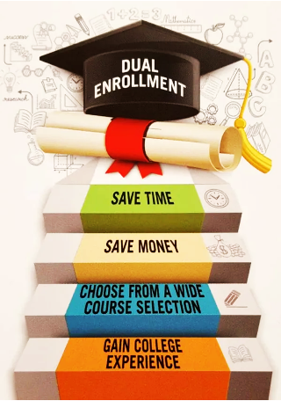
What is dual enrollment?
“Dual enrollment (or concurrent enrollment) refers to high school programs “which provide high school students the opportunity to enroll in college-credit courses taught by college-approved teachers.”
Dual-enrollment programs have long been popular among high school students in the United States, and are now going global. Students who successfully complete dual-enrollment programs not only save money and graduate from college early, but also develop the skills to manage college level coursework successfully.

Slide 13
Explorer Benefits
Partner Center Benefits:
Student Benefits:
Bolster curriculum: Add rigor and diversity to existing high school curriculum.
Teacher Development: We will train and approve your qualified teachers as Marquette adjunct instructors. Teachers have ample professional development opportunities.
Co-branding opportunities: Marquette can promote your institution and vice versa.
e-Library Access: Registered Explorer students and adjunct instructors have access to MU’s e-library collection (e-books, e-journals, etc.)
Become a more competitive college applicant: Stand out on your university applications. Students who complete the program will be able to send their MU transcript on to their future university.
Streamlined Application: Students have the opportunity to be exempted from standardized tests & other college application requirements.
Save Time and Money: Save time & money by getting a headstart on university courses while in high school. Enter university with advanced academic standing.
21st Century Skills: Better prepare yourself for university life abroad via U.S. university teaching method and assessment system.

Slide 14
Instructor Approval & Requirements
We will train and certify your qualified teachers as Marquette Adjunct Instructors. We will provide reference materials such as sample syllabi and professional development sessions.
Instructor Support:
Instructor requirements:
Our team will work with your instructors to ensure quality standards are met
Resources for curriculum-related questions
Our team will observe each course and provide feedback
Periodic site visits, professional development on-boarding training and summer symposium
Complete adjunct instructor online application. A master’s degree or at least 18 graduate credit hours in related academic discipline is required
Create course syllabus that complies with Marquette learning objectives
Attend on-boarding training session
Attend once-per-year summer symposium

Slide 15
Popular Course Offerings
ACCO 1030 | Financial Accounting
ACCO 1031 | Managerial Accounting
ANTH 2203 | Human Geography
BIOL 1001 | General Biology 1
BIOL 1002 | General Biology 2
CHEM 1001 | General Chemistry 1
CHEM 1002 | General Chemistry 2
COMM 1100 | Professional Communication
COMM 1200 | Media in Society
COSC 1000 | Introduction to Computer Science
COSC 1010 | Introduction to Software Development
ECON 1103 | Principles of Microeconomics
ECON 1104 | Principles of Macroeconomics
ENGL 1001 | Foundations in Rhetoric
ENGL 1002 | Foundations in Rhetoric 2
HIST 1002 | Growth of Western Civilization since 1715
HIST 1121 | Growth of the American Nation 2
HIST 1202 | History of Western Art 2
PHYS 1001 | General Physics 1
PHYS 1002 | General Physics 2
POSC 2201 | American Politics
PSYC 1001 | General Psychology

Slide 16
Explorer Admissions Requirements
GPA: Average high school GPA of 3.0 or higher on a 4.0 scale. If GPA is 2.5-3.0, students will need to participate in an interview and receive faculty recommendation.
English Language: Meet the minimum English proficiency requirement of 6.0 on IELTS or 100 on Duolingo. Students also have the option to take the Internal English Language Exam.

Slide 17
Program Implementation & Student Matriculation Partner: IPERC
IPERC is a US-based non-profit education organization that offers international education programs to students around the world. www.iperc.org
IPERC is Marquette’s international representative that helps to manage the Explorer Program.

Slide 18
University Applications after Explorer Program Completion
Option 1: Continue Education at Marquette University in the U.S.
Option 2: Apply to IPERC Partner Universities in the U.S., Canada, UK and/or Australia.
Option 3: Apply independently to other universities.

Slide 19
Enroll at Marquette University Directly
Qualified Explorer students will be guaranteed admission to Marquette University and receive a scholarship of between $20,000-$44,000 per year.

Slide 20
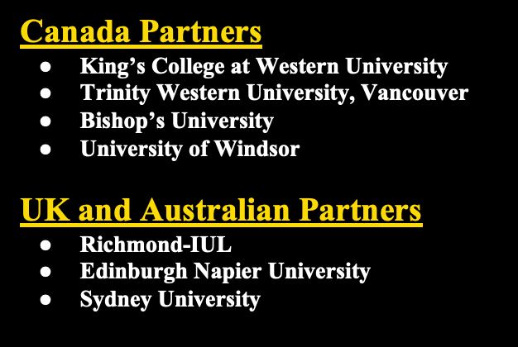
2. Apply to IPERC Partner Universities - receive guaranteed admission and English test waiver (8 Explorer courses required for Marquette English waiver)
University of San Francisco

Slide 21
3. Apply to Any US Universities. Top US Universities Accepting Marquette Transcripts Include:

Slide 22
4. Top Global Universities Accepting Marquette Transcripts:

Slide 23
Online Explorer Course Option
Students have the option to take Explorer courses online and in real-time through IPERC’s US-based, fully-accredited online high school (Ready Global Academy)
If your school cannot offer a specific course that a student may want to take, or if a student wants to take an extra course in the evenings, on the weekends or during school holidays, they can sign up independently.

Slide 24
We will fully support you!
Teachers: We will help to certify and train your teachers as adjunct instructors so that they will able to teach college-level courses.
Curriculum: We will provide reference materials for curriculum development (text book lists, sample syllabi)
Assessments: We will provide the online platform through which quizzes and tests may be accessed and students’ grades submitted.
College Application Process: IPERC will collect all student matriculation documents and submit them to ACCP universities to which students apply. IPERC will ensure that students meet the enrollment requirements.
Marketing support: We will organize for partner university admissions teams to visit your institution and can provide other marketing materials if there is an interest.

